Slide 1
British Airways Virtual Work Experience
Task 2
Predicting customer buying behaviour.

Slide 2
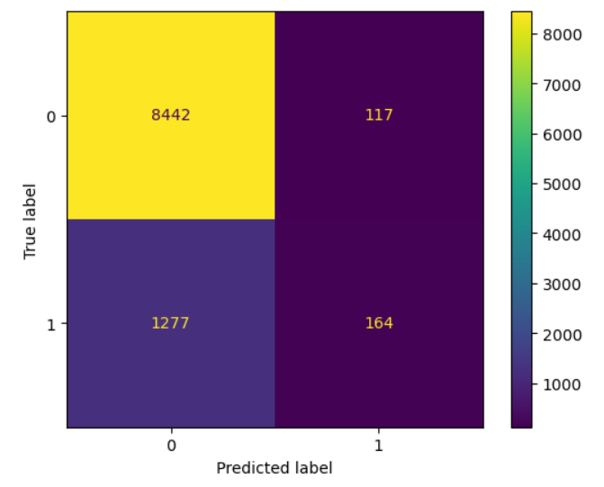
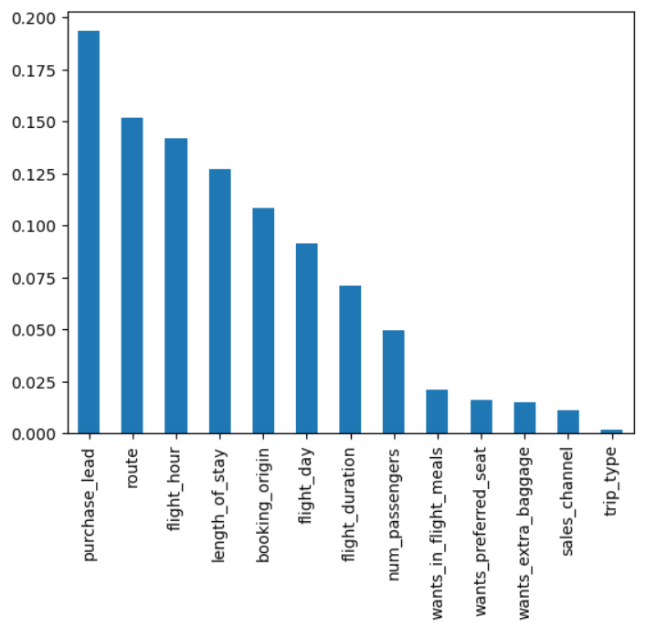
Customer Behaviour Analysis
Evaluation Metrics
Accuracy – 0.8606
Precision – 0.5836
Recall – 0.1138
Variable Contribution
Purchase lead and Route have the highest contribution towards customer booking conversion.

